Slide 1
Key Takeaways
Conclusion
2.2
Session

Slide 2
Key Financial Instruments

Slide 3
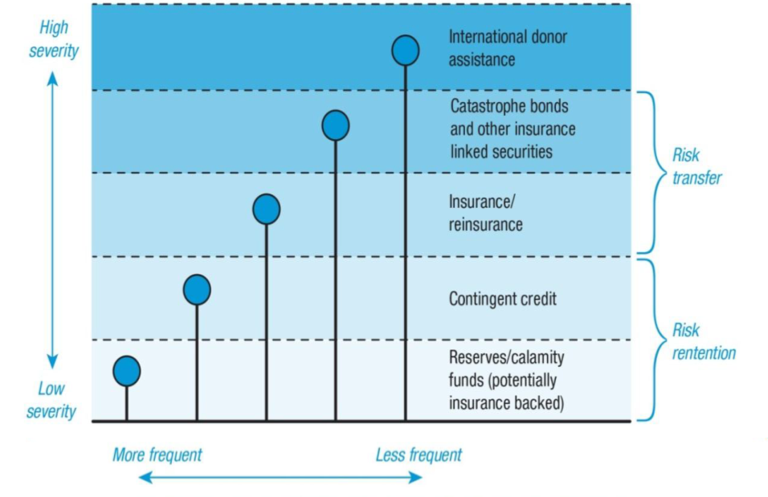
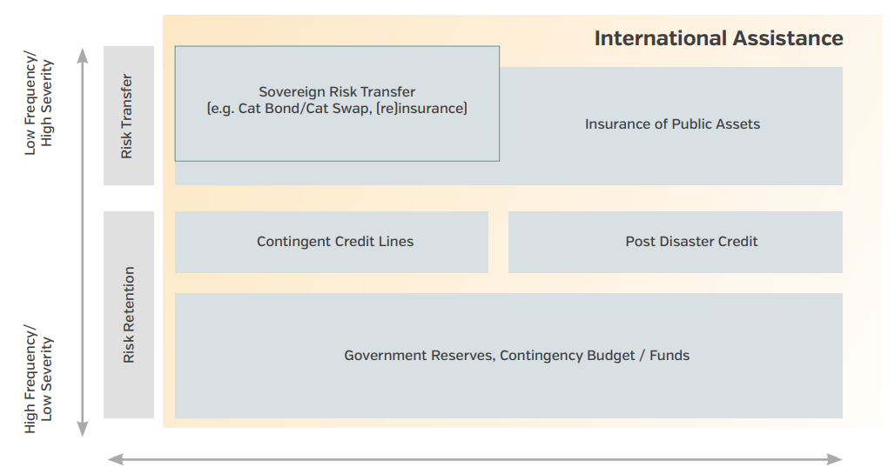
Layered Risks
Targeting the Manageable Tiers of Risks

Slide 4
IRFF Streams
Lines of Instruments
Budgetary Instruments
Contg./ Emergency Funds
Budgetary Reallocations
Contingent Financing
Contingent Lines of Credit
Post-Disaster Credit
Costly Loan Instruments
Market-Based Instruments
Sovereign Risk Transfer
(Insurance & Reinsurance)
b. ii. CAT Bonds
Innovative Instruments

Slide 5
Which instruments to get?
The target is achieving the right balance and mix of these instruments, as required in a given context.

Slide 6
Risk Retention Instruments

Slide 7
Budgetary Instruments
Emergency Funds/ Contingent Funds
Budgetary Reallocations
Internal Management
Higher Opportunity Cost

Slide 8
1. Contingency Funds
NATIONAL FUNDS TO FINANCE PREPAREDNESS, EMERGENCY RESPONSE AND RECOVERY ACTIVITIES.
Considered as relatively low-cost risk financing instruments and immediately available, they allow national and local agencies to develop realistic contingency plans. Such funds enable Governments to rapidly access resources to respond to a shock, which can avoid bureaucratic delays (need for verification, administrative accounting, disbursement scheduling, etc.).
Rules under which these funds are managed are so important to ensure they are available timely. In many countries contingency funds exist, however the conditions under which they disburse are vaguely written and often broad. In such instances, it can be a challenge to ensure sufficient funds are available which a shock occurs, especially when shocks occur later in the budgetary cycle, as the funds can be depleted.
Emergency fund Vs contingency fund
(Disaster definition)
- Contingency funds and contingency plan ?!?

Slide 9
2. Budgetary Reallocation
Definition and how it works
A budget reallocation is the mechanism allowing to use existing budget devoted to other uses/activities/department as per the initial/amended financial act but due to some circumstances, is utilized for activties/department other than what it was devoted/allocated to.
It is the redesignation of appropriated or budgeted funds from one account to another account or to a newly - created account for a different use or purpose.
Objective :
to provide liquidity to a department facing funds shortages due to disasters and allow him to cover response activities (relief, early recovery etc.) during emergency time.

Slide 10
Budgetary Reallocations
Budget reallocation or redesign as a tool for climate change financing and disaster risk management
Ultimate goal of financial instruments: financial resilience
Simply put, it is the ability to meet the expenses related to climate change and disaster risk management.

Slide 11
Negative effects of budget reallocations:
Tax exemptions, particularly for disaster response and rehabilitation activities, reduce tax revenues.
Losses in budgetary revenues lead to a decline in total government revenues.
Budgetary reallocation disrupts development efforts because it not only changes the order of priority of planned activities, but also does not allow for the full implementation of disaster response, recovery and reconstruction activities, given the lack of resources to meet emergency needs.

Slide 12
Negative effects of budget reallocations:
The reallocation or rearrangement of the budget between different budget lines increases the amount of budgetary expenditure and amplifies the budget deficit since the expenditure incurred as a result of the disasters is not initially foreseen and included in the state budget during budget planning.
Conclusion: public spending related to CC and climate disaster risks disrupts public finances since these fiscal impacts only increase the public deficit.

Slide 13
Contingent Financing
WB CAT DDOs
AfDB Contingent Financing
JICA Standby Emergency Credit
(SECURE 2.0)
Rapid Disbursement
Raising Debt Level Overnight

Slide 14
3. Contingent Lines of Credit
Definition and how it works
A contingent line of credit is line of credit (loan) which is disbursed to a country upon the occurrence of a pre-defined shock.
The terms and conditions of the loan (loan amount, fees, interest rate, duration, etc.) :
Agreed upon signing the loan agreement, prior to the disaster.
Objective :
to provide liquidity to the benefiting country immediately after a shock (natural hazard induced disasters / health-related emergencies).
The loan resources can be disbursed to the benefiting country as budget support (as a development policy loan, in exchange for systemic and institutional improvements to strengthen financial resilience) or against pre-agreed expenditures (investment operation).

Slide 15
Contingent Lines of Credit
BEST SUITED Possibility to have concessional financing terms given they are negotiated before a shock occurs and are offered by multilateral development banks. They therefore tend to be lowcost financing instruments, effective for financing response to moderate frequency, severity shocks. | IMPACTS ON DEVELOPMENT GOALS In the case of budget support loans, possibility to link them to a robust matrix of policy reforms which the beneficiary country must undertake to receive the loan (as with development policy operation). In the case of investment operations, the funds can be used to pay eligible expenditures which contribute to the attainment of development objective of the country.
ADVANTAGES Rapid access to funding in the event of a disaster / public health emergency / macro shocks, Supporting key reforms that strengthen the country’s ability to manage the impacts of disasters on the economy and the vulnerable. | DISADVANTAGES AND/OR CONSTRAINTS Completion of a limited set of prior actions and satisfactory implementation of a Disaster Risk Management (DRM) program, The Development Bank will monitor on a periodic basis, and x keep an appropriate macroeconomic policy framework

Slide 16
Risk Transfer Instruments

Slide 17
Risk Transfer
Market-Based Instruments
Sovereign Insurance/ Re-insurance
Public Assets Insurance
CAT Bonds
Enhances Protection
Higher Cost of Instruments

Slide 18
Risk Transfer
PRINCIPLES OF INSURANCE (RISK TRANSFER): An arrangement by which a company (or the state) undertakes to provide a guarantee of compensation for specified loss, damage, illness, or death in return for payment of a specified premium | TYPES OF COVERAGE : Indemnity cover: a guarantee to restore the insured to the position he or she was in before the uncertain incident that caused a loss for the insured Parametric cover: Index is created based on the severity of a specific natural hazard. If a hazard event occurs which exceeds a pre-defined threshold on the index (e.g. rainfall in province below 50 millimetres) a payout is triggered E.g : Agriculture insurance: can be parametric (based on an index) or indemnity (based on actual loss) Public asset insurance: indemnity insurance for key public assets (bridges, roads, power plants
KEY PROVIDERS : Domestic insurance companies, International reinsurance companies, Sovereign Risk Pools: Countries can pool risks in a diversified portfolio, retain some of the risk through joint reserves and capital, and transfer excess risk to the reinsurance and capital market | BEST SUITED: High-risk layer In the case of the lower-risk layer, where costs are smaller and more frequent, it is inefficient to pay an additional premium to cover these costs.

Slide 19
Innovative Finance Instruments
4,1, Forcast Based Financing : A system to fill gaps in the humanitarian system by using in-depth weather forecast information to anticipate possible impacts in risk-prone areas and mobilize resources automatically before an event. The goal of FbF is to anticipate disasters, prevent their negative impacts and, if possible, reduce human suffering. FbF system allows humanitarian responders, meteorological services and communities to agree on selected actions that are worth carrying out once a forecast reaches a certain threshold of probability. Each action is allocated a budget and funds are disbursed once the threshold is reached, according to predefined standard operational procedures.
4,2, Fiscal measures (tax policy at national or subnational level) Incentives to sensitize private sector to engage more actively in supporting DRR and DRM, And also play important role to supporting relief and emergency response : Tax rate decrease/exemption if contributing to relief (tax policy based on certain defined amount of contribution) | Tax policy at local level (municipality) as Adaptation and/or mitigation measures to climate changes impacts Disaster Risk Reduction incentives/contribution For better land use planning ➔ very powerful tools and internal funding source of CDRF at local level ➔ Disasters could/should be considered as opportunity to advance sustainable development by the means of CDRF (if properly and well planned)

Slide 20
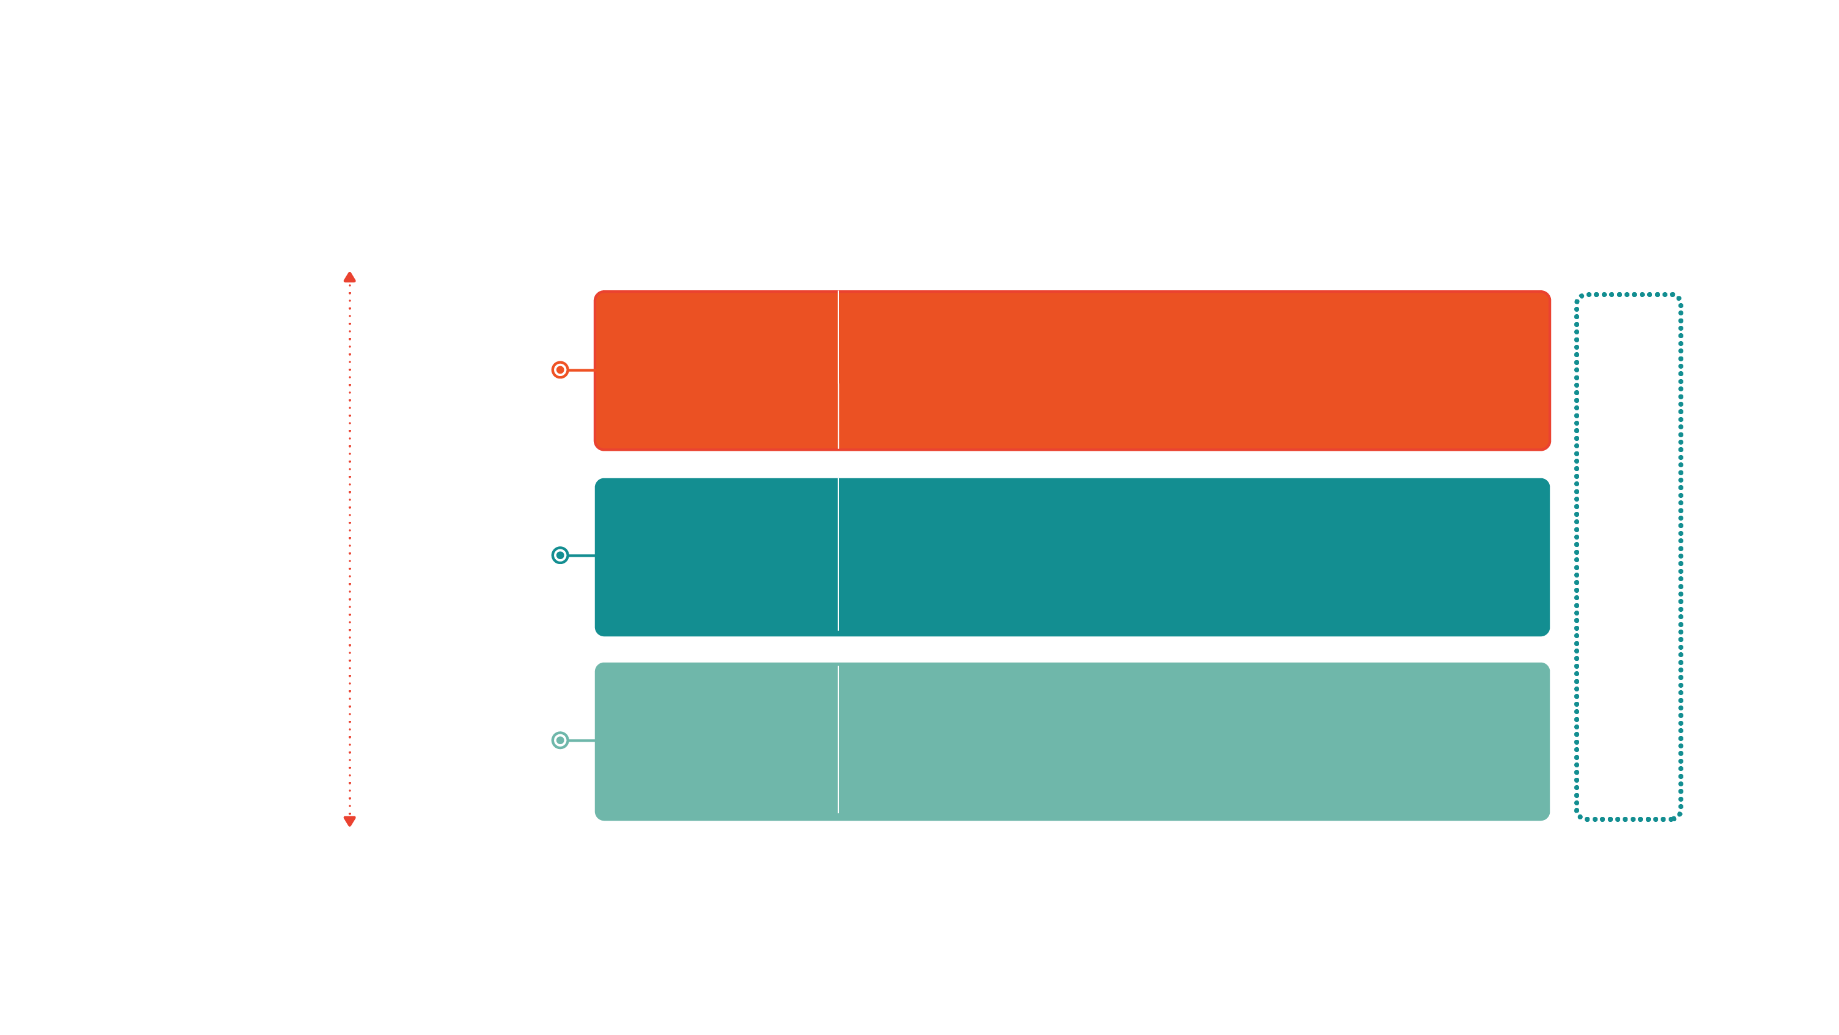
Parametric Covers
Parametric insurance as one component of a DRF strategy
Hazard Type
Financing instrument
Market-Based Instruments
Risk Transfer
Risk transfer for assets such as property insurance or agricultural insurance and risk transfer for budget management like parametric insurance, cat bonds/swaps
Low Frequency/
High Severity
Financial instruments that provide liquidity immediately after a shock
International Assistance (uncertain)
Contingent Financing
Contingent Credit
High Frequency/
Low Severity
Budget Reserves/
Reallocations
Reserve funds specifically designated for financing disaster related expenditures, general contingency budgets, or diverted spending from other programs
Budgetary Instruments

Slide 21
Issues and challenges of climate change
and climate disaster risk:
Climate-induced disasters interrupt or slow down economic growth by, among other things:
Destroying both public and private infrastructure, and
causing direct physical damage that contributes to the decrease of the GDP (destruction of factories, hotels, means of production, trade, houses that serve as a place of productive activities) etc.
Leading to indirect macroeconomic losses.

Slide 22
Macroeconomic indirect losses from climate change
and disaster risks can be:
The decline in current account transactions, particularly because of the decline in agricultural exports (cocoa, vanilla, corn, rice, etc.)
The increase in the import of food products,
The decrease in income from tourism services (hotels, restaurants, transport, trade in handicrafts, etc.)
The loss of tax revenue due to exemptions for food imports that are exempt from import duties and taxes in order to meet emergency and recovery needs
The decline in budget revenues and the increase in budget expenditures, which increases the budget deficit.

Slide 23
For more information:
Irff.undp.org

